Slide 1
Google Competition
Agent VS – Adaptive Staffing Intelligence
Team: Analytics Science
Guoqian Zeng j_zeng@berkeley.edu
Gerson Morales gerson_morales@berkeley.edu
TIanyu Qi tqi4@berkeley.edu Yilin Chen cali_elaine@berkeley.edu

Slide 2

Contents
Background & Problem Statement
EDA & Key insights
Simulation of 2025 Data
Model：Semi-Markov Decision Processes
Performance Comparison & Sensitivity Analysis
Suggestions
Futurework

Slide 3

Solution
1. Background & Problem Statement
Google Ads Experts staffing plan：The problem requires designing an adaptive staffing plan that balances advertiser demand, staffing constraints, and revenue optimization while ensuring efficient client-agent assignments.
Dataset: We were given historical dataset 2023-2024 from advertisers across 20 countries
Challenge: The unpredictable daily influx of new accounts and the dynamic nature of employee availability makes staffing optimization a challenge.

Slide 4
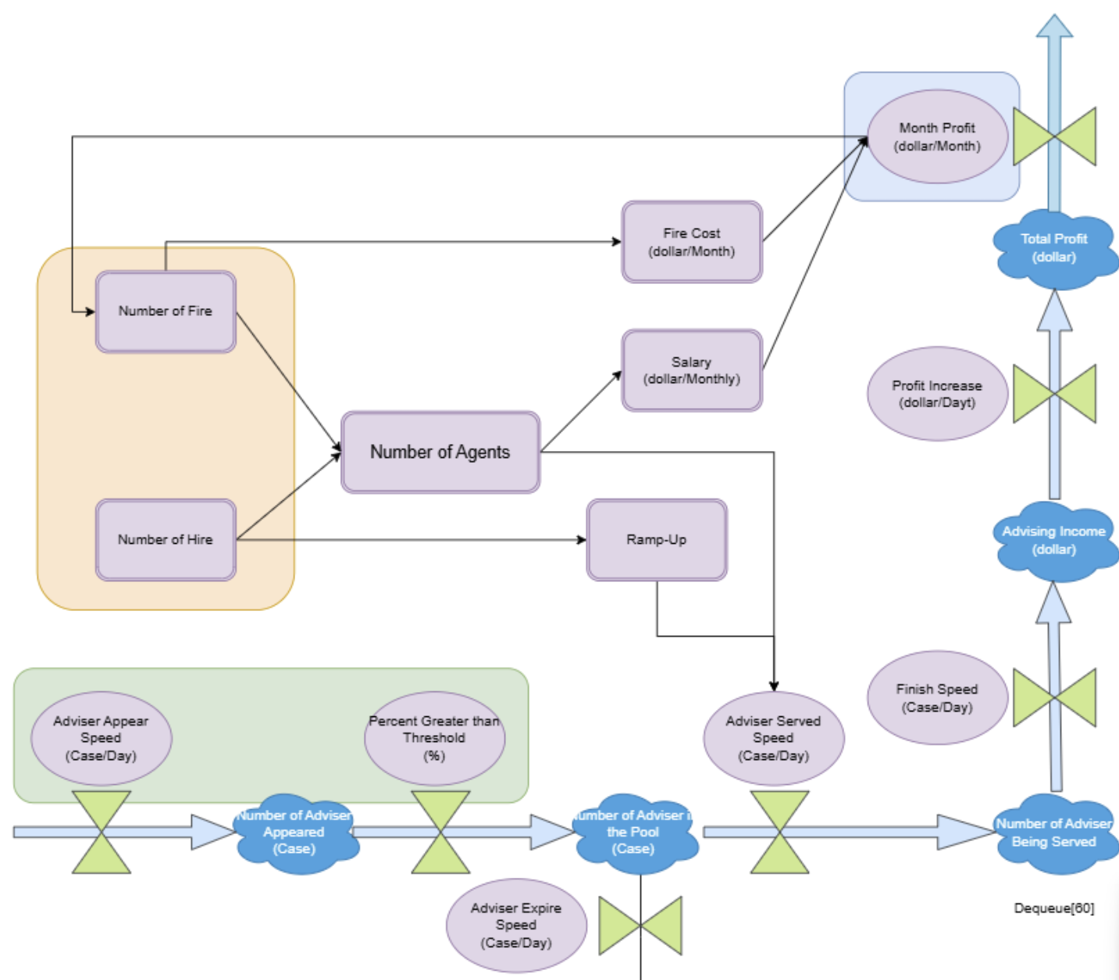
1. Background & Problem Statement
Question Analytics with Systematic Mapping
Advertiser-to-Revenue Flow: How our company operates
Controllable Variables
Hire/Fire Variables: Main focus in optimization system
Delay
Final Balance: We believe in monthly variables could achieve optimal values
Generated Inflow
fixed, dequeue, delay, feedbacks…in presentation

Slide 5
Solution
2. Exploratory Data Analysis & Key insights
Given the data structure of the three tables provided, we made the following visualizations that gave us insights to create time series and simulation analysis
Sign Up Quantity per Country
EDA Tableau Story

Slide 6
Solution
3. Simulation of 2025 Data
Time Series: Intuitive, but not as accurate as we thought:
one/two year is to short for predicting
no feature without and external data given
Switch to Simulation, we compare:
Brownian motion
Gaussian Process
Non-homogeneous Poisson Process

Slide 7
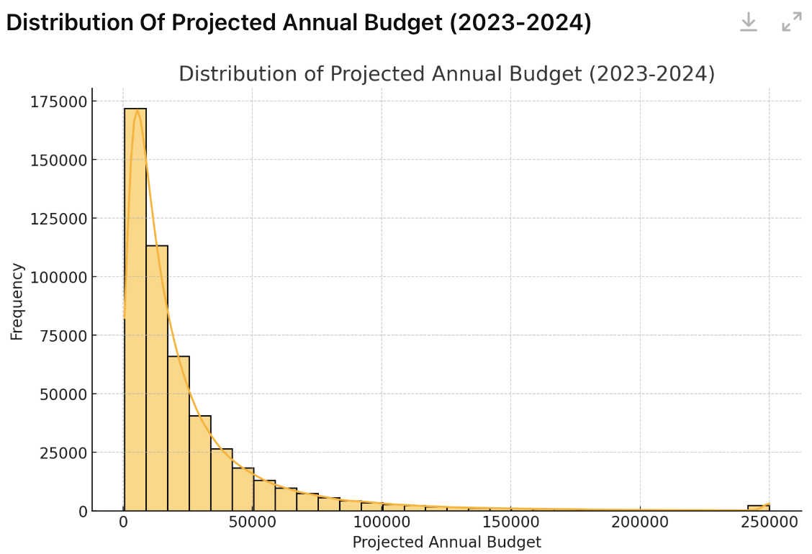
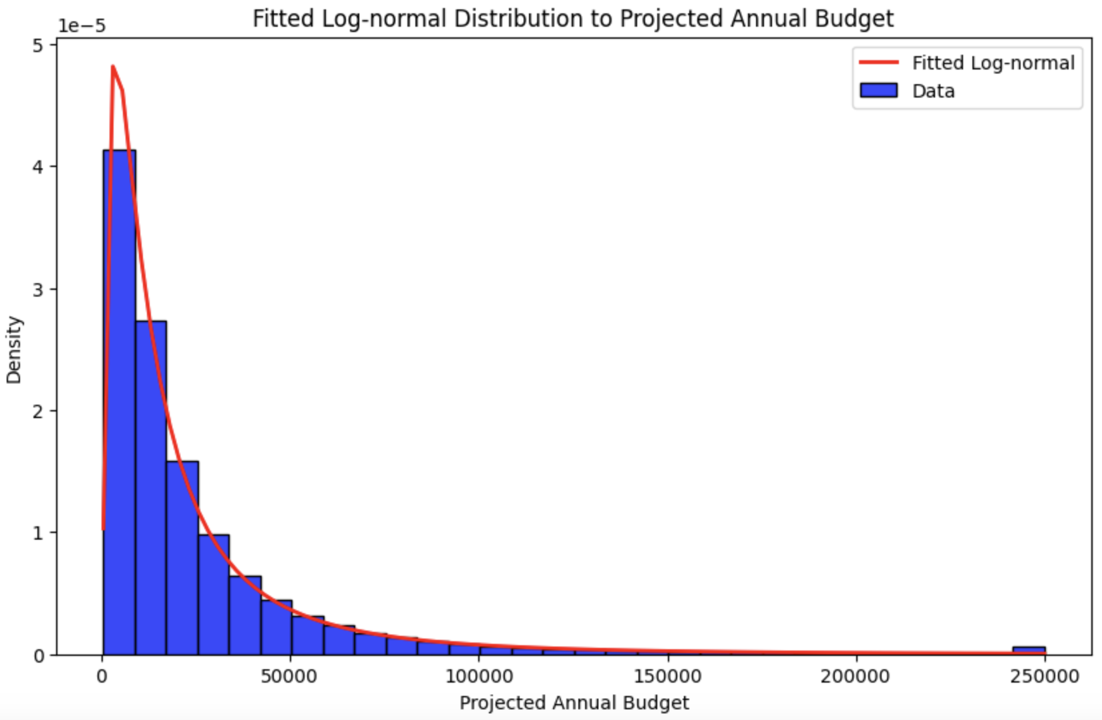
Solution
3. Simulation of 2025 Data
Distribution of Sign Up Dates: Since sign up dates follow the poisson distribution, we use Non-homogeneous Poisson Process to simulate 2025 sign up dates.
Distribution of Predicted Budget: The distribution of predicted budget for 20
countries are all Lognormal Distributions.

Slide 8

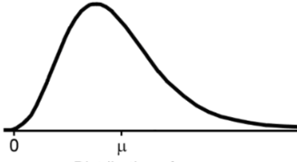
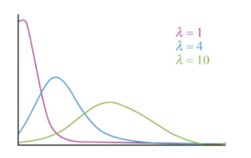
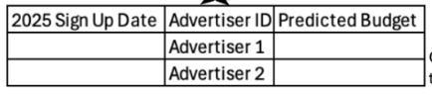
Solution
4. Model: Semi-Markov Decision Processes
4. 1. Dynamic Process Analysis：We analyse the whole dynamic process in three perspective：Data input，Data Processing and Data Output.
Strategy：Fire/Hire on the first day of the month
Data input
Non–homogeneous Poisson Process to simulate sign up date
Distribution of predicted budget
—Log Normal
Output Tables after simulations for 2025

Slide 9
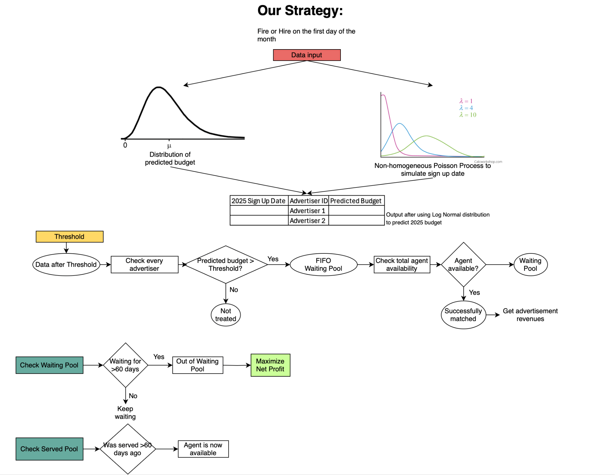
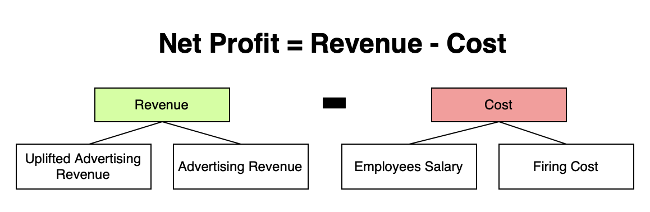
4. 1. Dynamic Process Analysis
Solution
4. Model: Semi-Markov Decision Processes
Dynamic Data Processing
Data Output

Slide 10
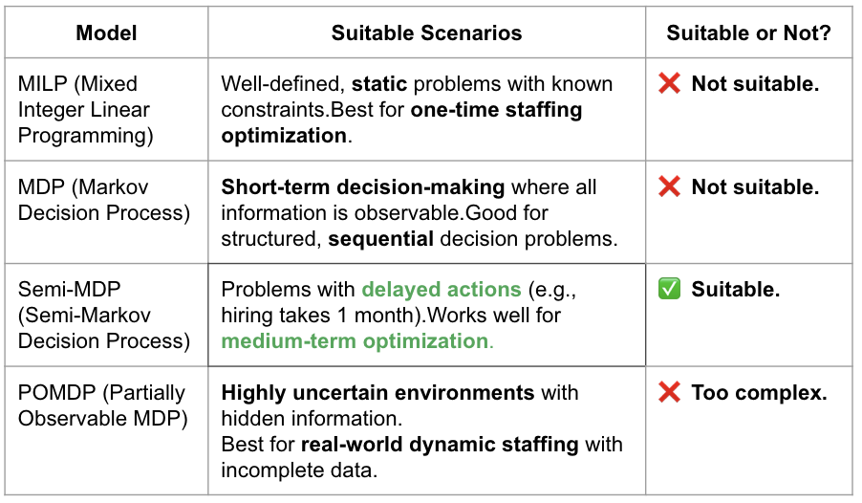
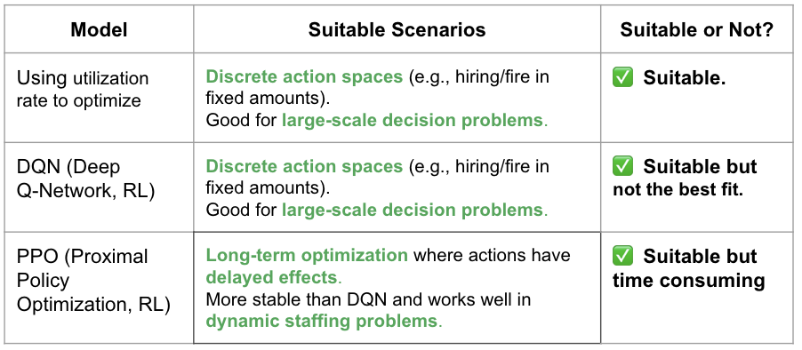
Solution
4. Model: Semi-Markov Decision Processes
4. 1. Choice of Model based on two key challenges
The delay of Hiring/Firing decision effect：The real effect of hiring/firing decision won't start until next month.
Dynamic and irregular decision timing：Hiring/Firing decision made by month but advertisers sign up by day, leads to different Action Space.
Semi-MDP：Models time-delayed effects of decisions Learns the best decision-making policy
Using utility rate to optimize & Reinforcement learning
Model Comparison
Model Comparison

Slide 11
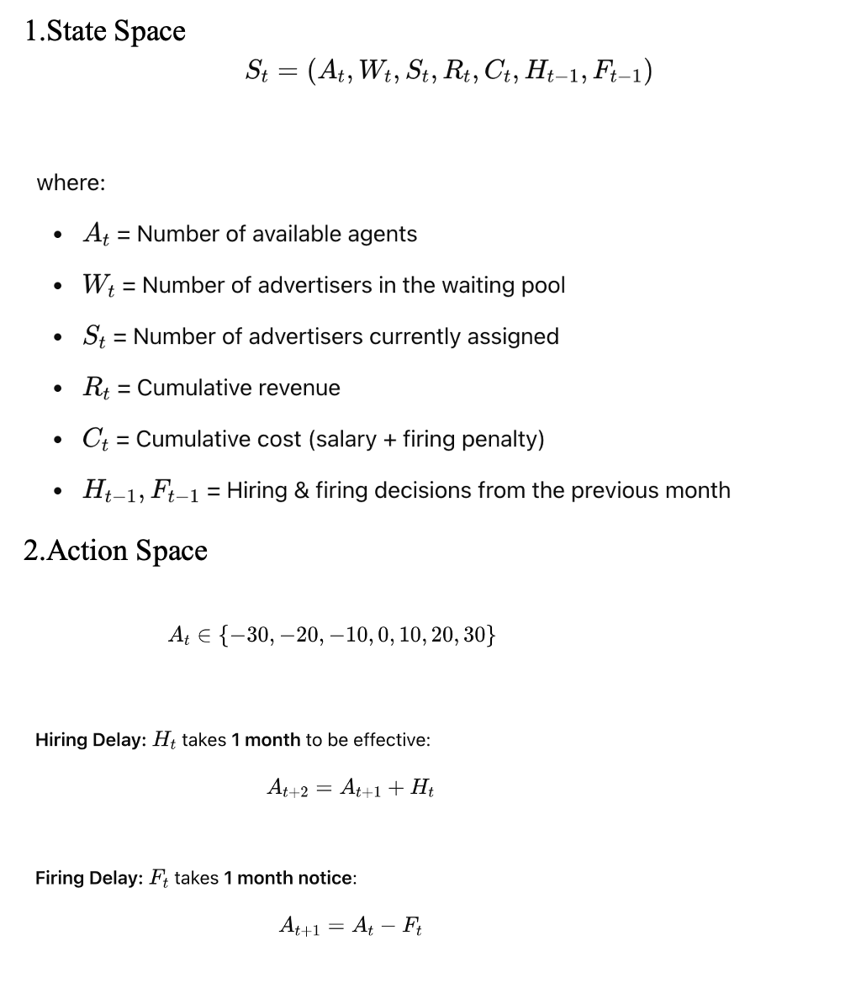
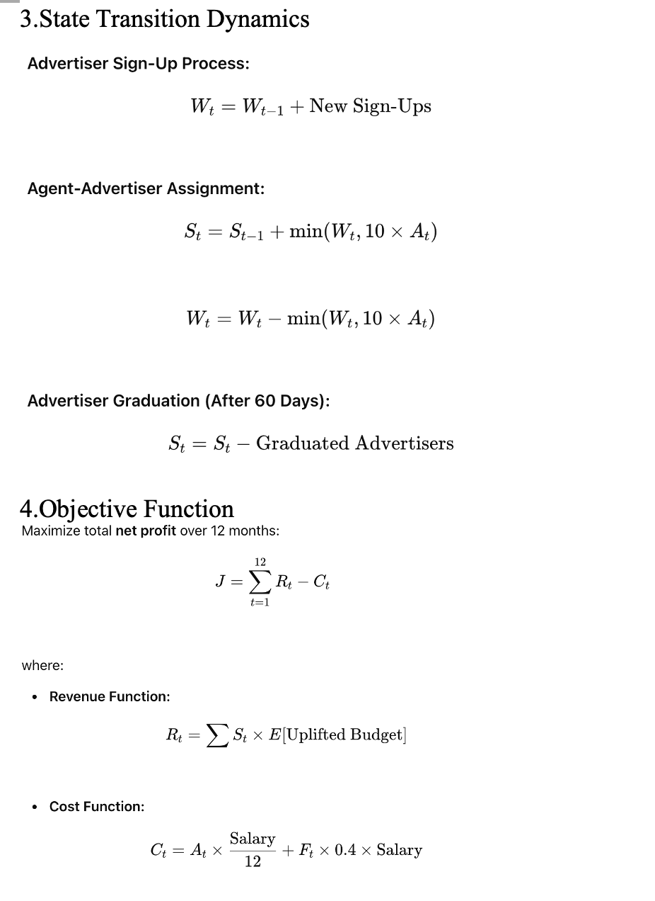
Solution
4. Model: Semi-Markov Decision Processes
Semi-Markov Decision Processes Model

Slide 12
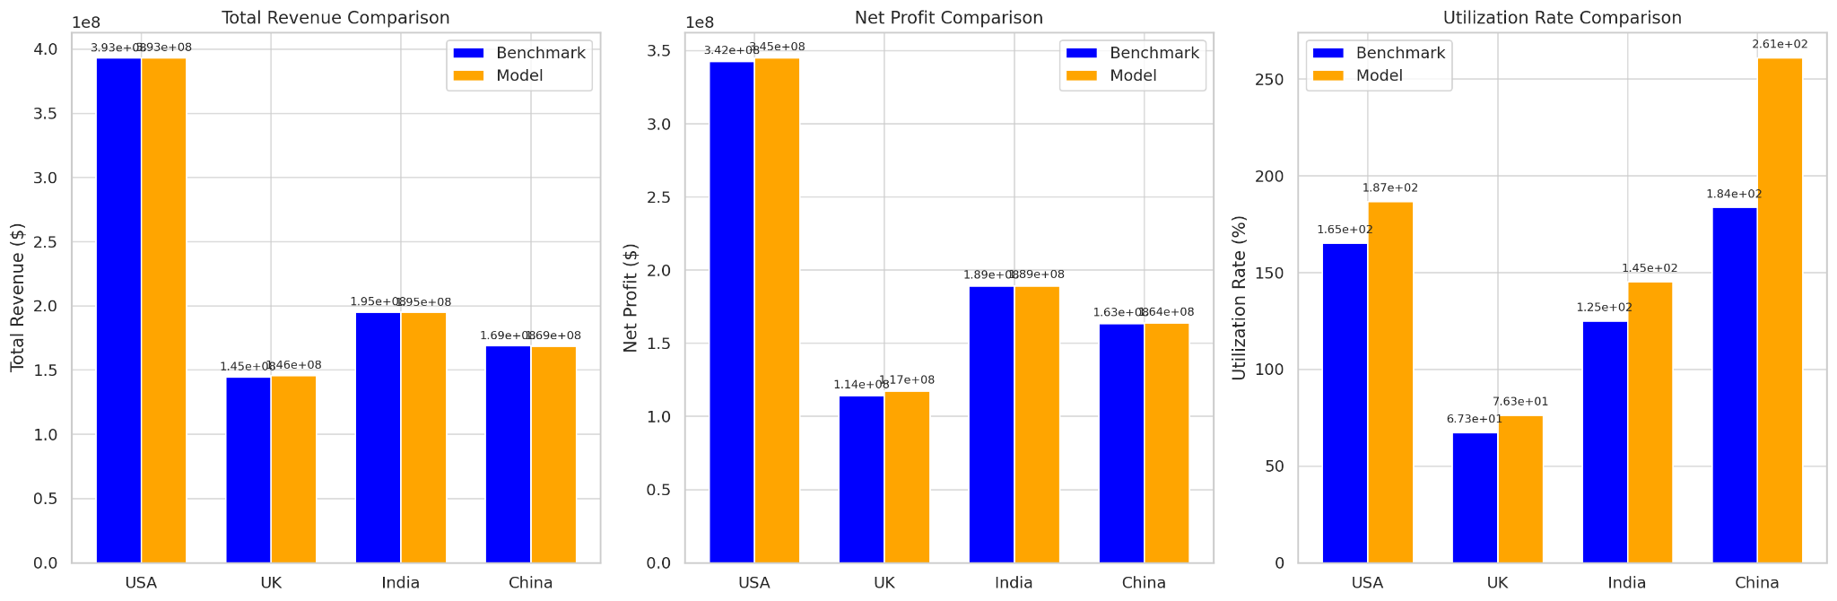
Solution
5. Performance Comparison & Sensitivity Analysis
We implement three models: Benchmark Model(No Hiring or Firing),Semi-MDP & utility rate as optimization method and Semi-MDP & DQN(deep Q-Network)（without enough computing power to finish).
Benchmark Model
Semi-MDP & utility rate as optimization method
$1,293,332 higher than Second model for USA!
HIgher than Benchmark’ net profit:
USA: $2,718,676.86
UK: $3,109,699.53
India: $150,586.55
China: $287,660.28

Slide 13
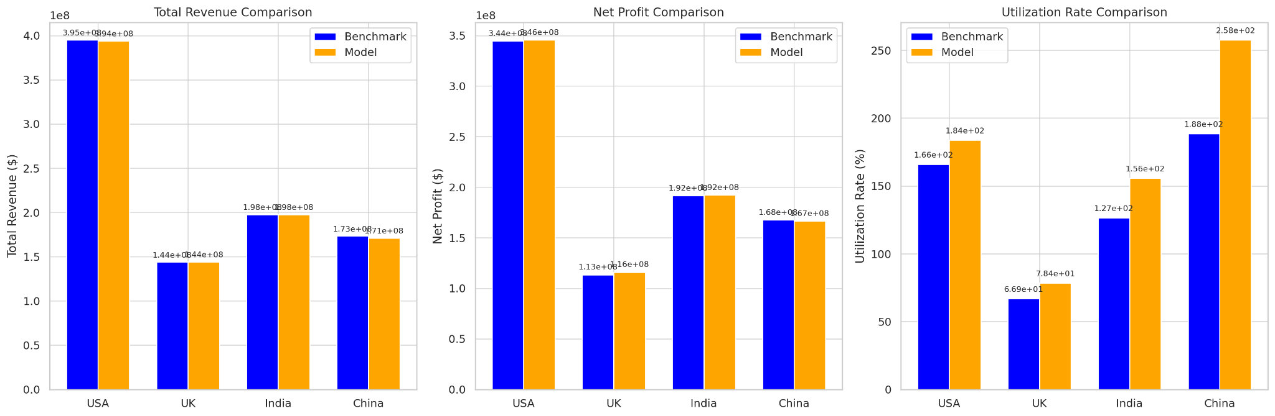

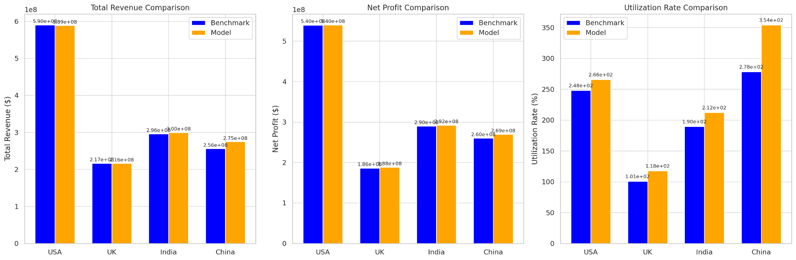
Solution
5. Performance Comparison & Sensitivity Analysis
This model ADAPTS to many extremes!
We simulate three market extremes for sensitivity analysis.
(1) As users of google's newly launched products may not adapt to them, the number of signs up dropped sharply in a certain 1-2 months, and then recovered to a normal level
Higher than Benchmark’ net profit:
USA: $1,269,794.78 UK: $2,481,857.65
India: $533,471.82 China: -$1,111,863.44 (decrease)
(2)Google rolled out a marketing strategy that suddenly led to a huge increase in users. Q4 sign up is doubled.
Higher than Benchmark’ net profit:
USA: $2,385,481.15 UK: $2,632,364.60
India: $1,680,741.35 China: $399,483.86
(3)The market picked up in 2025, with the number of signs up increase by 50% every month throughout the year.
Higher than Benchmark’ net profit:
USA: $443,152.10 UK: $1,877,738.83
India: $1,965,008.37 China: $9,286,974.22

Slide 14
Solution
6. Suggestions
Enhance Scalability with Reinforcement Learning: Invest in computational resources to implement DQN-based staffing policies, which can continuously self-improve and adapt.
Pilot-Test Before Full-Scale Rollout: Implement a 3-6 month pilot in a mid-sized market (e.g., UK or Canada), monitor performance metrics, and refine the model before scaling globally.
Improve Market Responsiveness with Forecasting： If demand surges unexpectedly, reactive hiring may be too slow due to training delays.Integrate machine learning-based demand forecasting to predict advertiser sign-ups and adjust hiring before demand spikes.

Slide 15
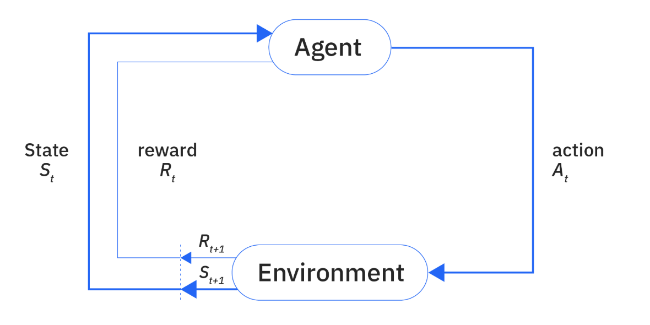


Solution
7. Futurework
Model Improvement: Continuous work on reinforcement learning
Adding Penalty function & reward function: If advertisers receive service after 30 days，which may lead to lower service satisfaction, we could discount their expected uplifted budget accordingly.
Optimize firing strategy：Firing agents with low uplift contributed first

Slide 16
Google Competition
Thanks for Listening！
Team: Analytics Science

